Slide 1
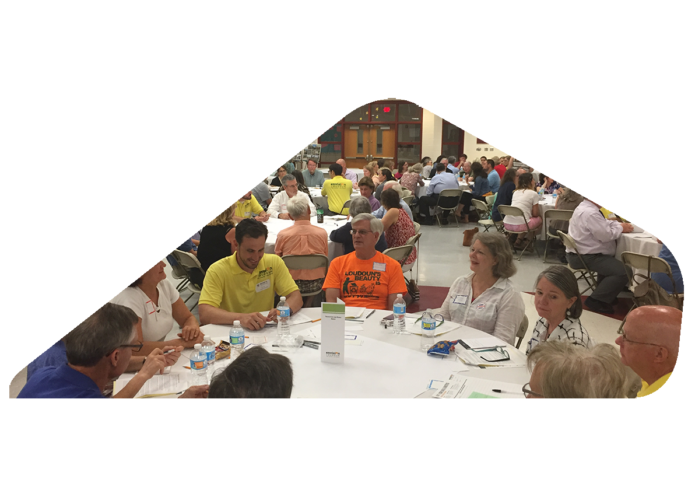
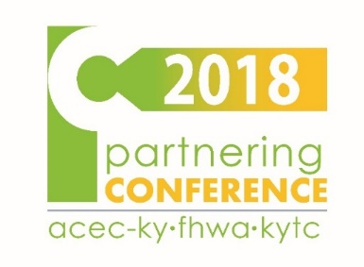
Tactical Approach to Public Engagement
Mixing It Up
September 5, 2018
Presentation

Slide 2

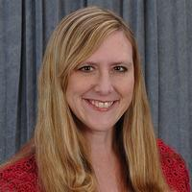
Today’s Objectives
Learn how public engagement can help align transportation decision-making with broader community initiatives
Participate in example visioning and priority setting activities
Hear how this approach is being applied in Bardstown
Aaron Heustess, P.E.
Lexington, KY
Jonathan Whitehurst, AICP
Charlotte, NC
Lindsay Walker, P.E.
Lexington, KY

Slide 3
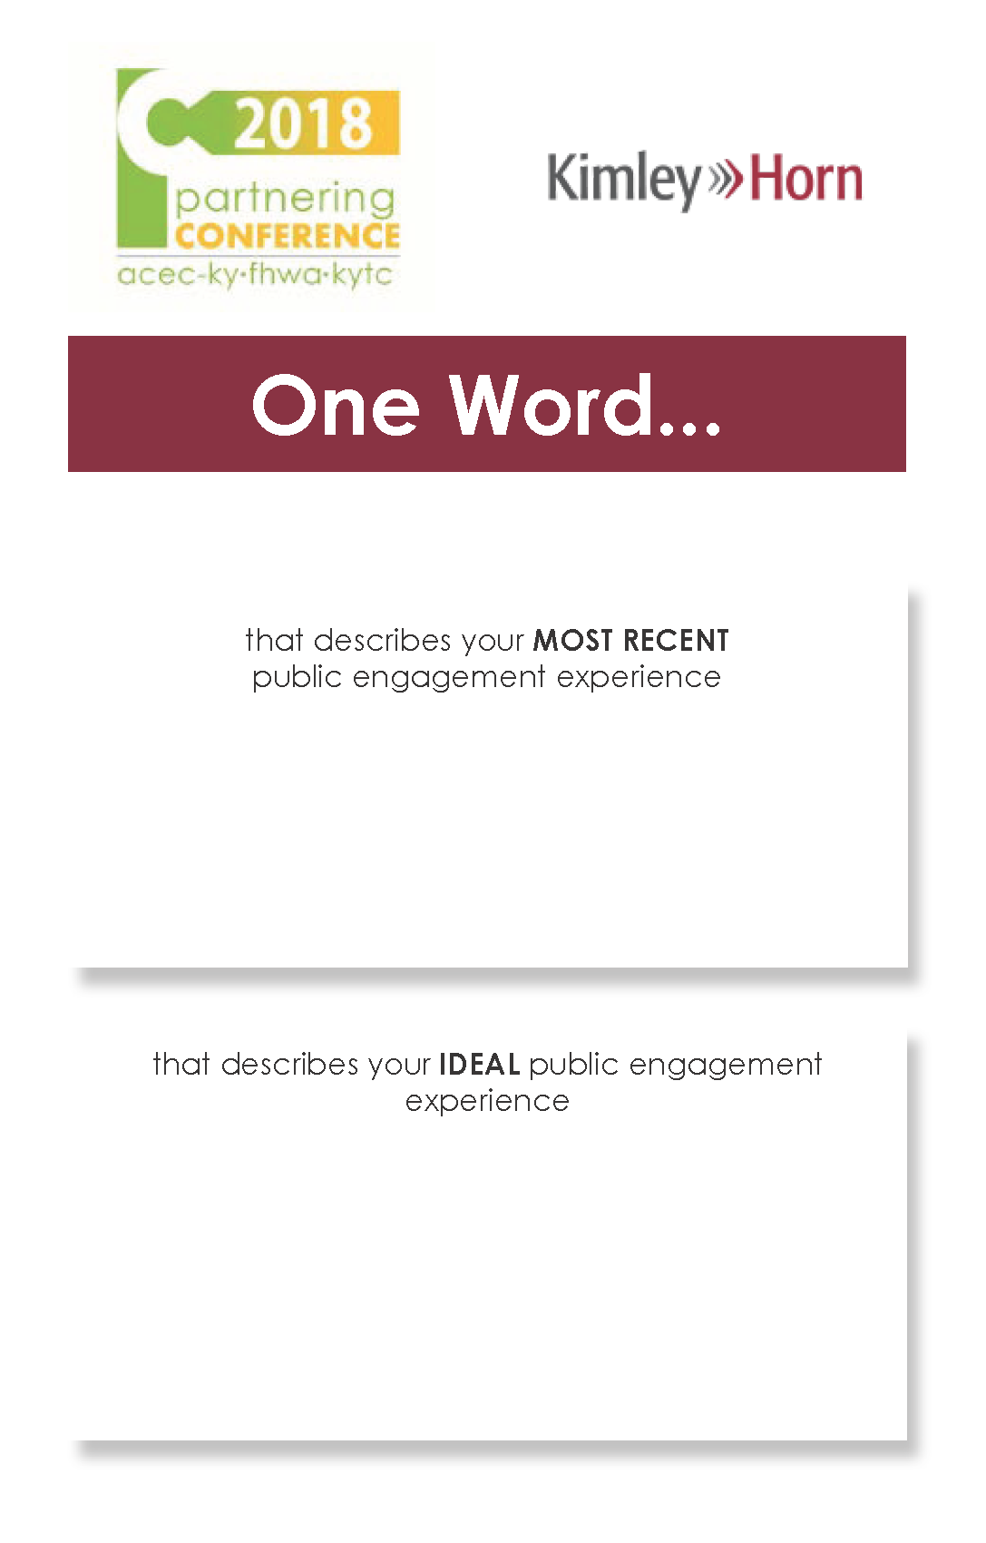
One Word
Take a moment…

Slide 4
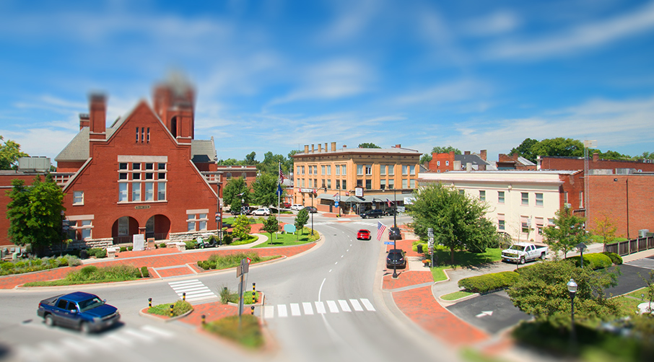
Things we can agree on.
We can make better places by creating better transportation choices.
There is value in the voices of strategic stakeholders and everyday citizens.
Current plans can be a starting point for future strategies.
The process should include ways to determine if you’re on the right track—now and later.

Slide 5


Things that challenge us.
How do we engage the “middle”?
How do we deal with competing interests?
How do we determine if we’re on
the right track?
How do maintain momentum throughout the project…and beyond?

Slide 6
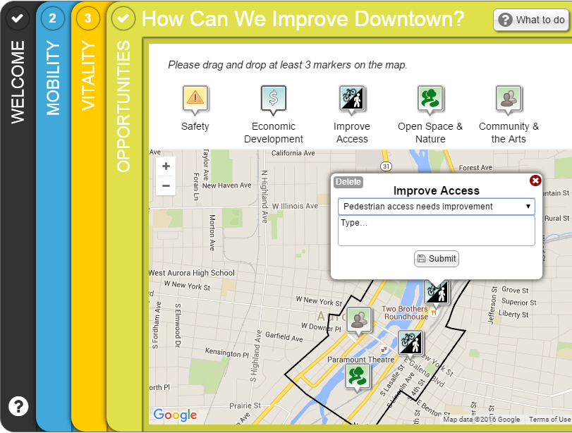
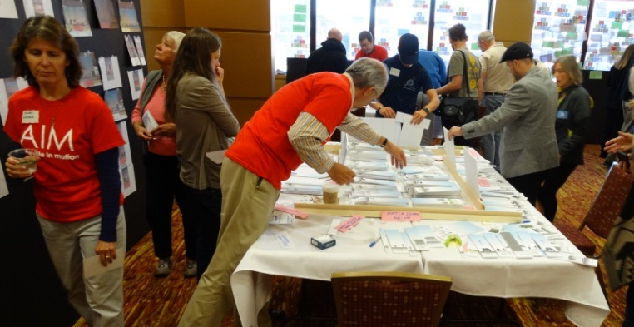
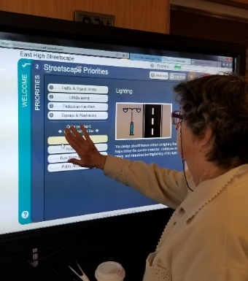
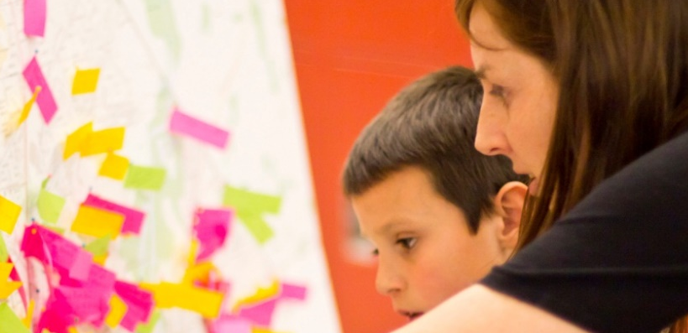
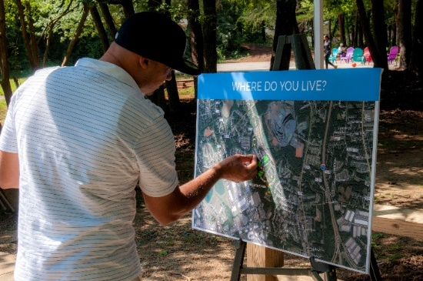
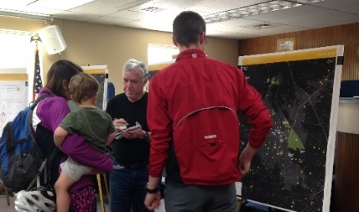
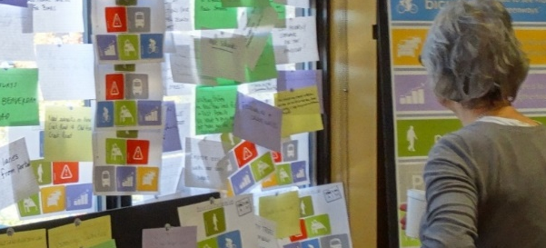
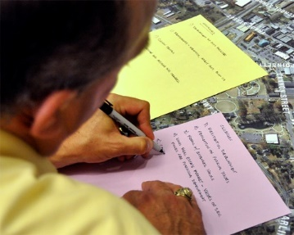
Who are we trying to reach? How?
How will we generate meaningful input?
How will we use the data?
Engagement
Awareness | Visioning | Accountability

Slide 7
Conventional Approach (solving for “x”)
ASPIRATIONS
GOAL SETTING
PLAN
FUND
BUILD
VALUES
Competing priorities
Limited transportation dollars

Slide 8
Progressive Approach
VALUES
ASPIRAT-IONS
GOAL SETTING
PLAN
FUND
BUILD
Project Development
Project Execution

Slide 9
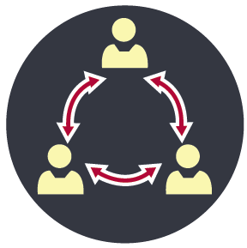



A tactical approach…
Get the right
people talking
Generate ideas
Synthesize outcomes
Communicate process and results

Slide 10

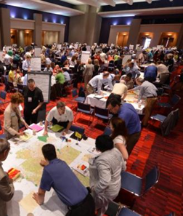
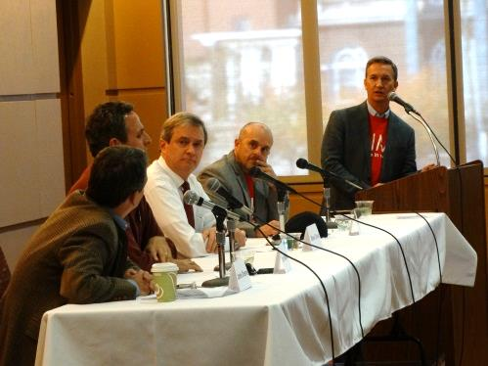
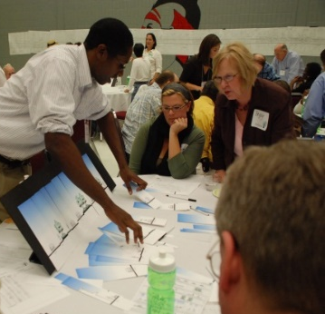
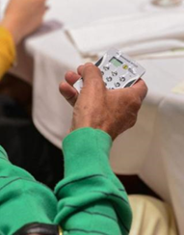
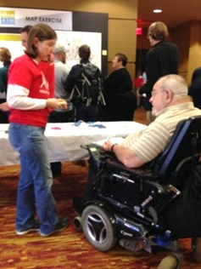
Set Targets
NUMBER
Select methods that create interest
and participation
INCLUSIVITY
Ensure geographic and demographic representation
QUALITY
Organize around consistent themes to feed momentum and inform the process

Slide 11
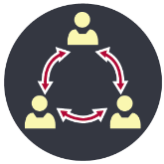
Get the right
people talking
Elected Officials
Business Owners
Bicyclists
Staff
Pedestrians
Understand the stakeholders…
Developers
Agencies
Committees and Commissions
KYTC
Residents

Slide 12
Get the right
people talking
Community Workshops
Online Engagement
Stakeholder Symposium
Website
Open House
…and how they are best engaged.
Project Committees
Design Charrette
E-Newsletters
Branding
Fact Sheets
Stakeholder Interviews

Slide 13

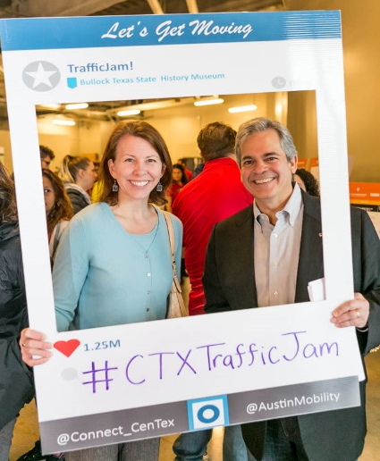
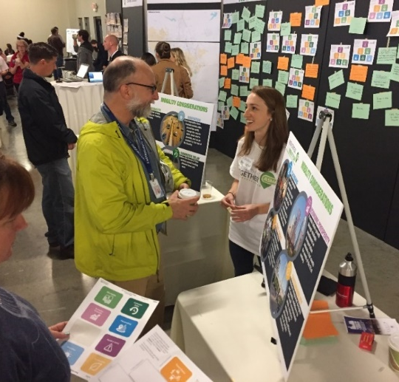
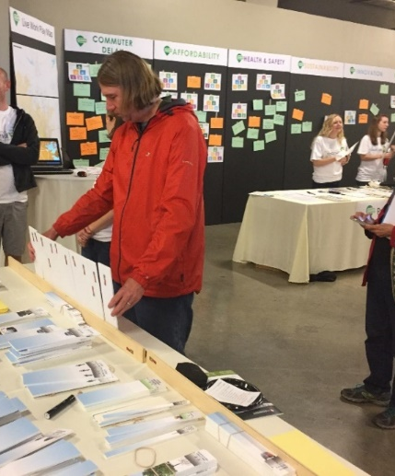
Engagement Strategy
(not just techniques)
Generate ideas
Get the right
people talking
Define success
Mobilize stakeholder groups
Identify techniques
Be sure that you know how you will use the collected information!

Slide 14
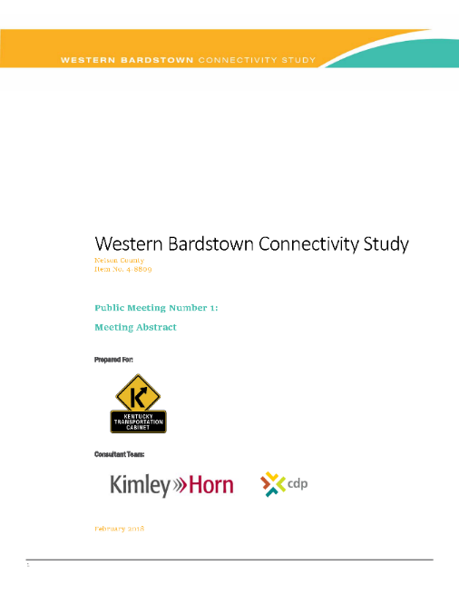


Generate ideas
Get the right
people talking
Information Wall
More or Less
One Word
Event Abstract
Overview of Event
  Meeting Info
  Objectives
  Agenda
  Targeted audience
  Marketing strategy
Activity Details
  Time to Complete
  Intent
  Description
  Outcome
  Materials
Bike Tour
Recommendations X-Ray
MetroQuest Survey
Exit Questionnaire
Thought Wall
Walkabouts
Comment Card
Panel Discussion
Street Builder
What do you see?
Priority Pyramid
Park Puzzle
Strong Places / Weak Places
Scrolling Presentation

Slide 15

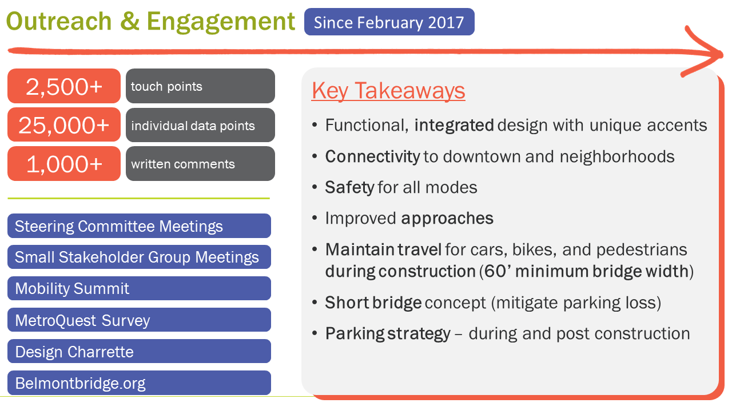
Synthesize
outcomes
Design activities to work
across multiple platforms
Emphasize volume of participation where appropriate
Show outcomes by
activity and by event
Summarize key takeaways

Slide 16

Communicate
process and results
Involve decision makers and stakeholders from the start
Align evaluation or prioritization criteria with goals
Make deliverables clear, concise, and easy to understand
Use engagement to create a clear vision and supporting goals
Identify champions and empower them to help with implementation

Slide 17
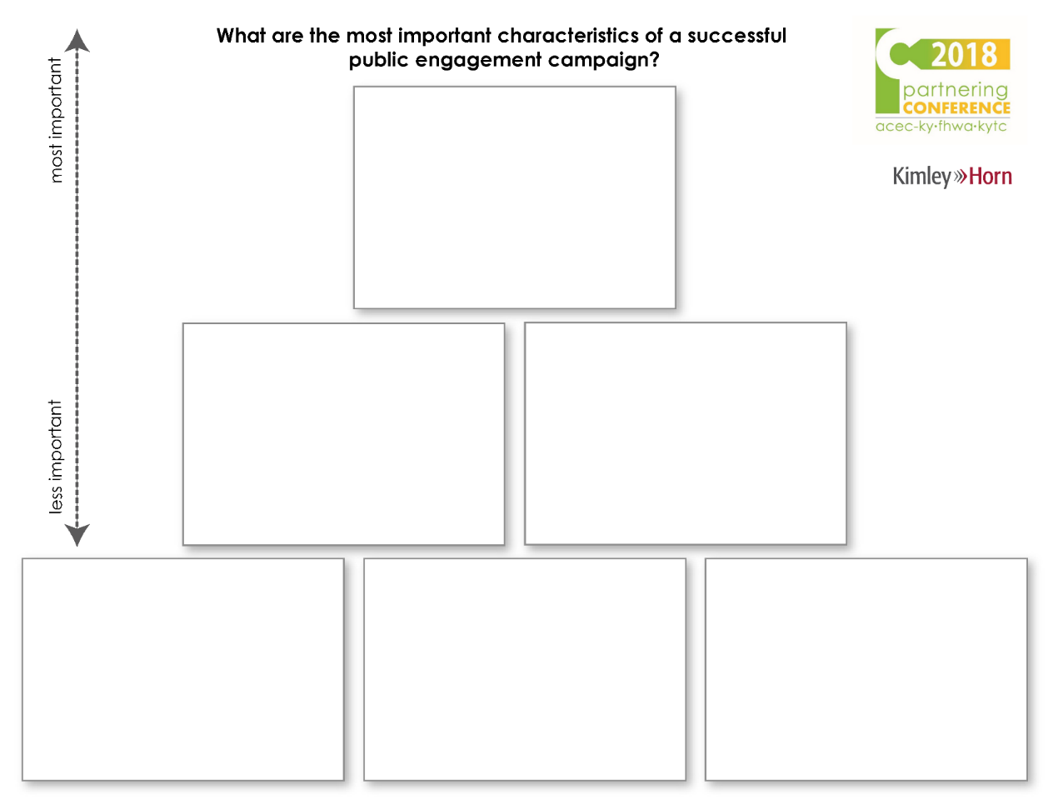
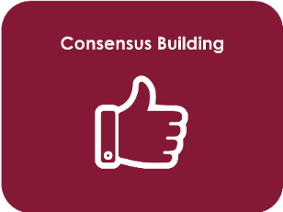


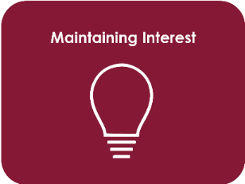
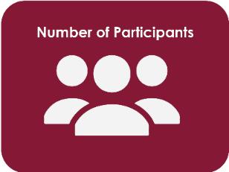
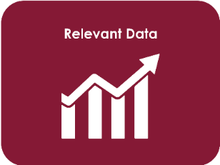
Priority Pyramid
Take a moment…

Slide 18
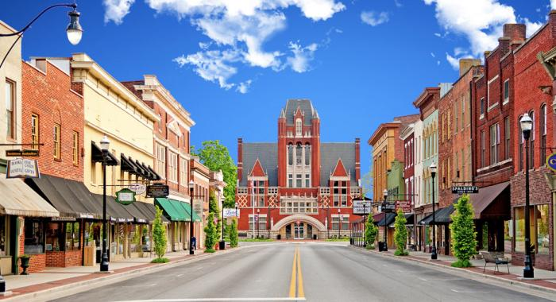
Case Study
Western Bardstown Connectivity Study
Purpose
To improve network connectivity to the west of Bardstown and reduce congestion and crash rates in the downtown area

Slide 19
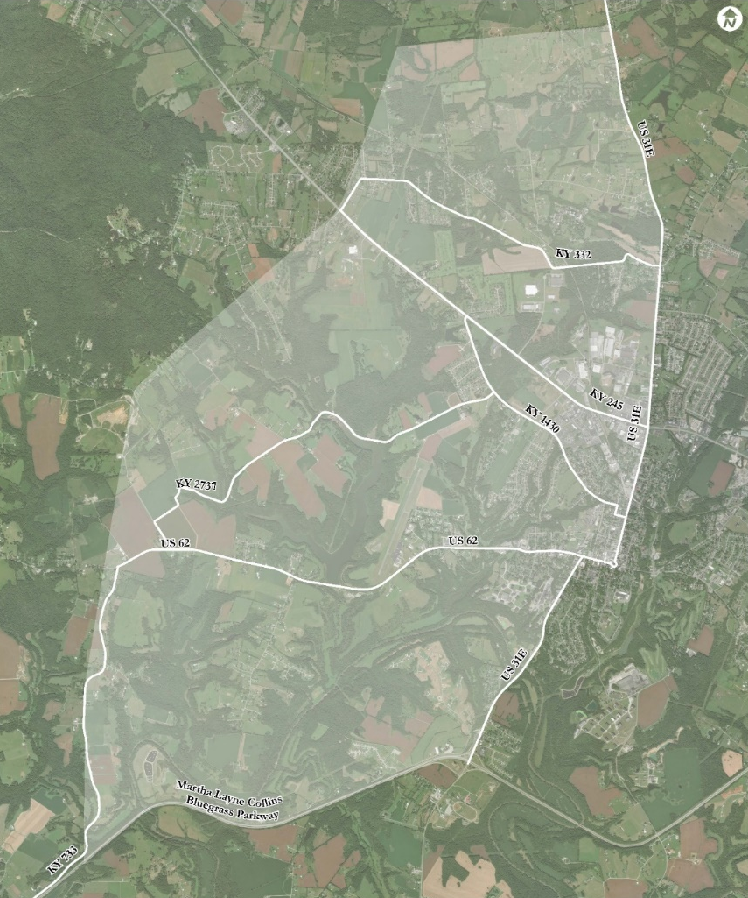
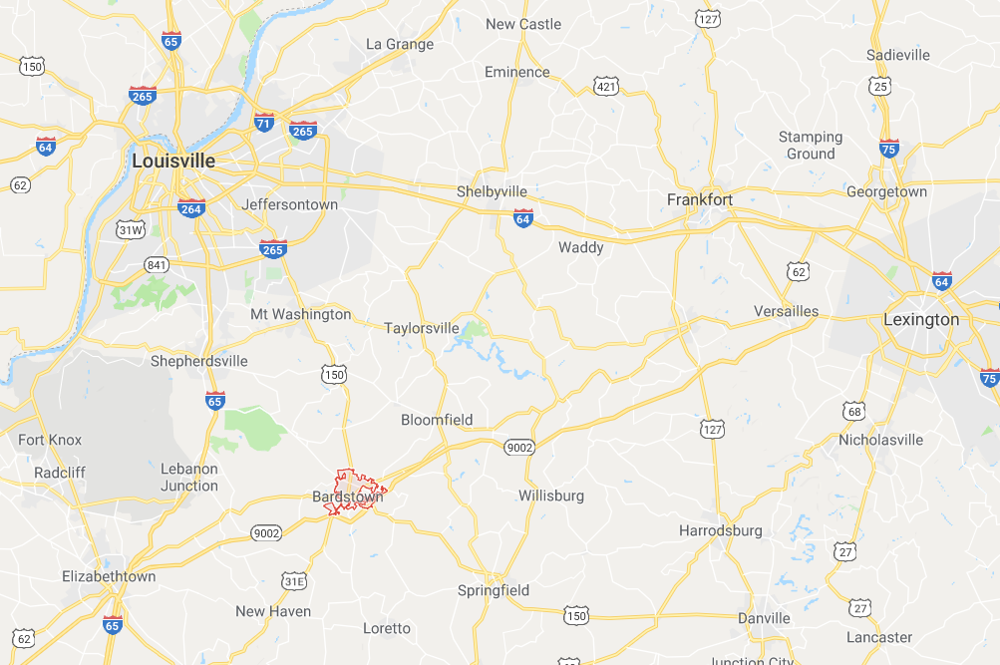





Case Study
Western Bardstown Connectivity Study
Background
New Route identified in the Nelson County 2035 Comprehensive Plan
Identified in 2014 Highway Plan
Competing needs based on location
Planning study initiated
Louisville
Lexington
Elizabethtown
BARDSTOWN

Slide 20
Public Engagement Plan
Case Study
Western Bardstown Connectivity Study
Objectives
Engage key community leaders
Offer decision points for citizens
Ensure diverse representation
Build support and participation
Raise awareness to regional transportation issues
Targeted Outreach
Municipal staff
Nelson County staff
KYTC
FHWA
Elected officials
State and Federal agencies
Public transportation providers
Freight operators
Nelson County Fire and EMS
Nelson County schools
Major employers
Chamber of Commerce
Economic development agencies
Bicycle and pedestrian advocates
Community leaders
Minority and low-income communities
Elements of Participation
Project Team Meetings (4)
Public Meetings (2)
Local Officials Meetings (2)
MetroQuest Survey (2)

Slide 21
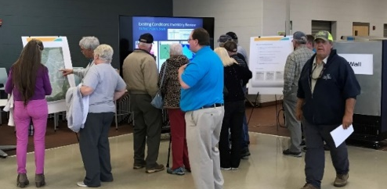
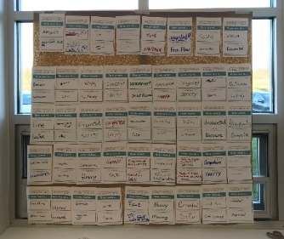
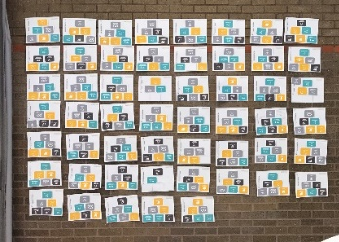
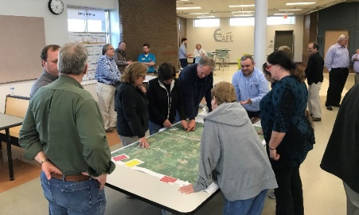
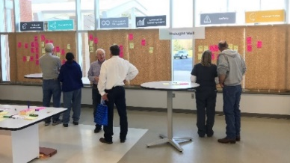
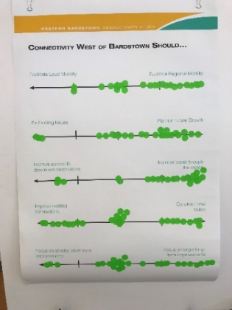
Public Meeting #1
Case Study
Western Bardstown Connectivity Study
April 17, 2018
Format
Interactive Open House
Objectives
Identify community values through a variety of interactive exercises
Educate the public on constraints and opportunities associated with connectivity in the study area
Gather feedback on a variety of potential tradeoffs
Activity Stations
Scrolling Presentation
One Word
Priority Pyramid
Thought Wall
Strong Places /
Weak Places
Tradeoffs

Slide 22
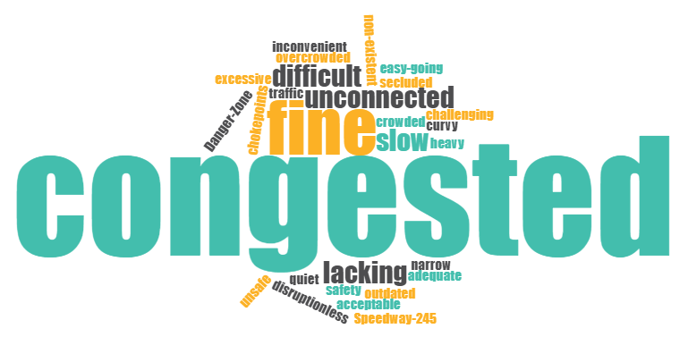
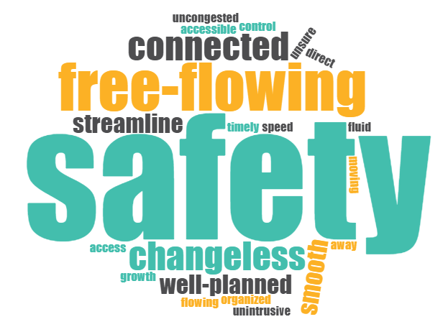
Case Study
Western Bardstown Connectivity Study
One Word
Gather broad views on existing and future vision
One Word…that describes transportation in western Bardstown
Today
In the Future

Slide 23


Case Study
Western Bardstown Connectivity Study
Priority Pyramid
SAFETY
Allow individuals to express a priority for a set of considerations
Ranked the top six categories
Introduced tradeoffs
Same categories used in the MetroQuest Survey

Slide 24
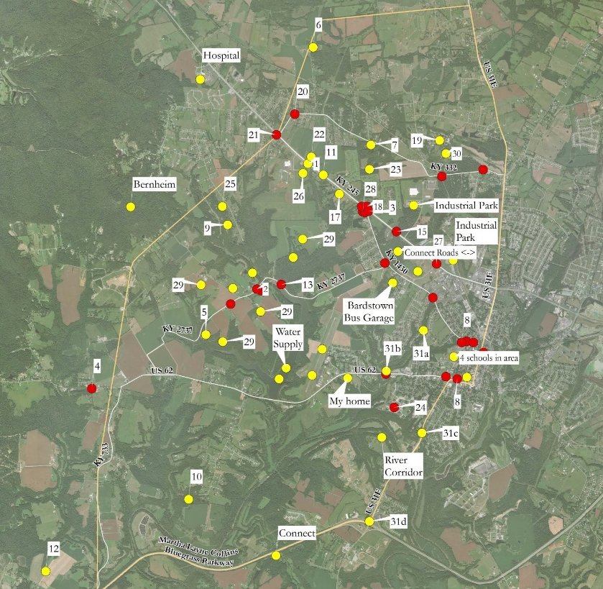
Case Study
Western Bardstown Connectivity Study
Strong Places / Weak Places
Identify strengths to be leveraged and concerns to be evaluated
Colored dots placed on a map, with dozens of locations identified
Results digitized in ArcGIS
Similar activity included in the MetroQuest survey

Slide 25
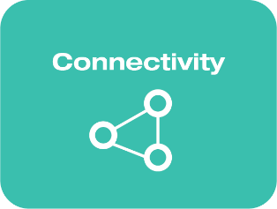


Case Study
Western Bardstown Connectivity Study
Thought Wall
Collect individual thoughts and open-ended feedback
Participants wrote individual comments on single pieces of colored paper with one sheet reserved for their most important comment
Comments were posted on a wall beneath a banner representing the most relevant connectivity consideration
Comments were entered into a spreadsheet and ranked by FREQUENCY (how many total comments) and INTENSITY (how many most important comments) per consideration
FREQUENCY
INTENSITY
1
2
3

Slide 26


Case Study
Western Bardstown Connectivity Study
Tradeoffs
Introduce tradeoffs and assist with decision making
Asked the question: Connectivity west of Bardstown should…
Dots were placed on large boards with tick marks
Similar tradeoffs used in the MetroQuest Survey

Slide 27

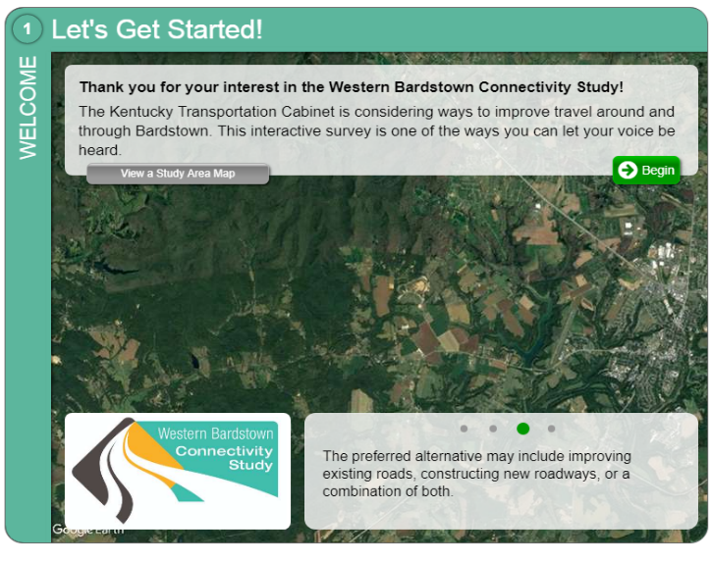
MetroQuest Survey
Case Study
Western Bardstown Connectivity Study
Safety ranked as top priority followed by Travel Time and Connectivity
Provide alternatives for regional traffic
Focus on smaller projects
Overview
Launched at Public Meeting #1
Established priorities, consider tradeoffs, and identified strong and weak places
Results considered in tandem with Public Meeting feedback
357
participants
4,038
individual data points
377
written comments
4/17 to 5/1
survey period

Slide 28
Case Study
Western Bardstown Connectivity Study
Get the right
people talking
Targeted outreach to stakeholders and elected officials in addition to public meetings
Generate ideas
Designed and executed a multilayered interactive engagement strategy
Synthesize
outcomes
Blended results from engagement platforms and used results to inform evaluation criteria
Communicate
process and results
Public Meeting #2 to include a “What We Heard” station and show how this information was used to narrow the list of potential corridors

Slide 29
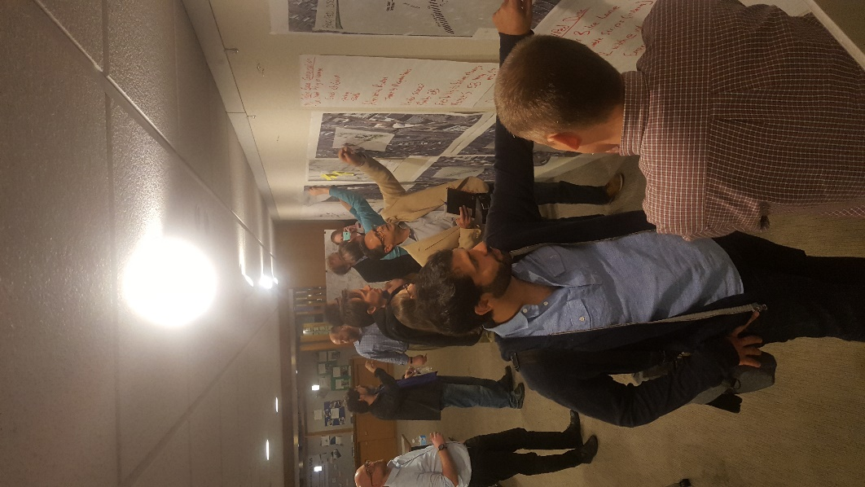
Actionable Input | Ongoing Participation
Best Practices
Leverage diversity of opinion but don’t demand consensus
Put outreach data on par with technical data
Establish goals and targets
Align activities with planning themes
Show participants the influence of their participation
Know your Participant Acquisition Cost
Notes:
Unlimited capacity for thought…limited time to participate.
Outreach can be fun but the purpose isn’t to entertain.
Participant acquisition cost should be considered when developing your strategy.
Know how you intend to use the collected information.

Slide 30
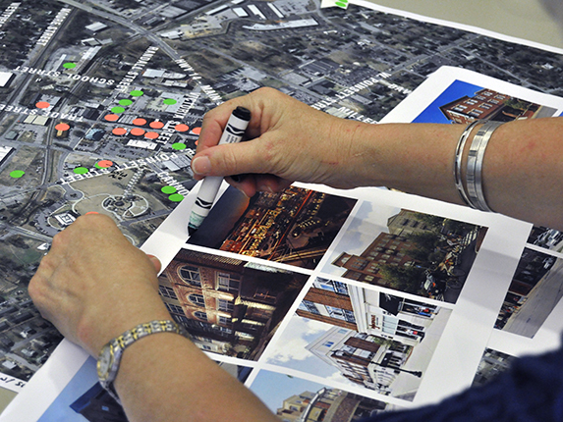

Thank you!
www.kimley-horn.com

